Slide 1

Deep learning Unpacking Transformers, LLMs and image generation
Session 2

Slide 2
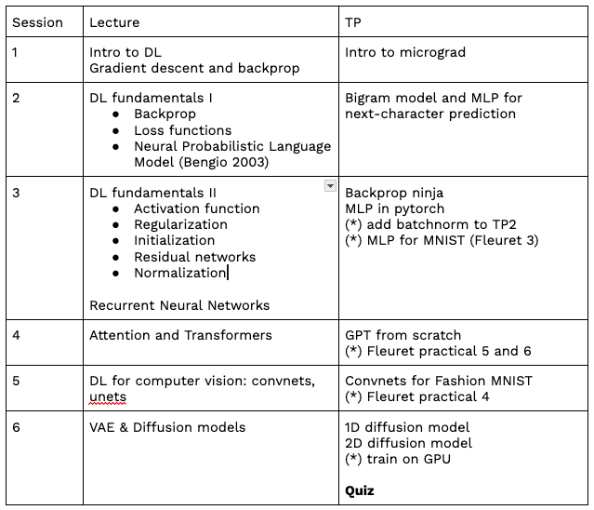
Syllabus

Slide 3
Let’s venture into the variations of a deep networks
Network architecture and inductive bias
Loss function
Activation function
Regularization
Initialization
Residual networks
Batch norm, layer norm

Slide 4
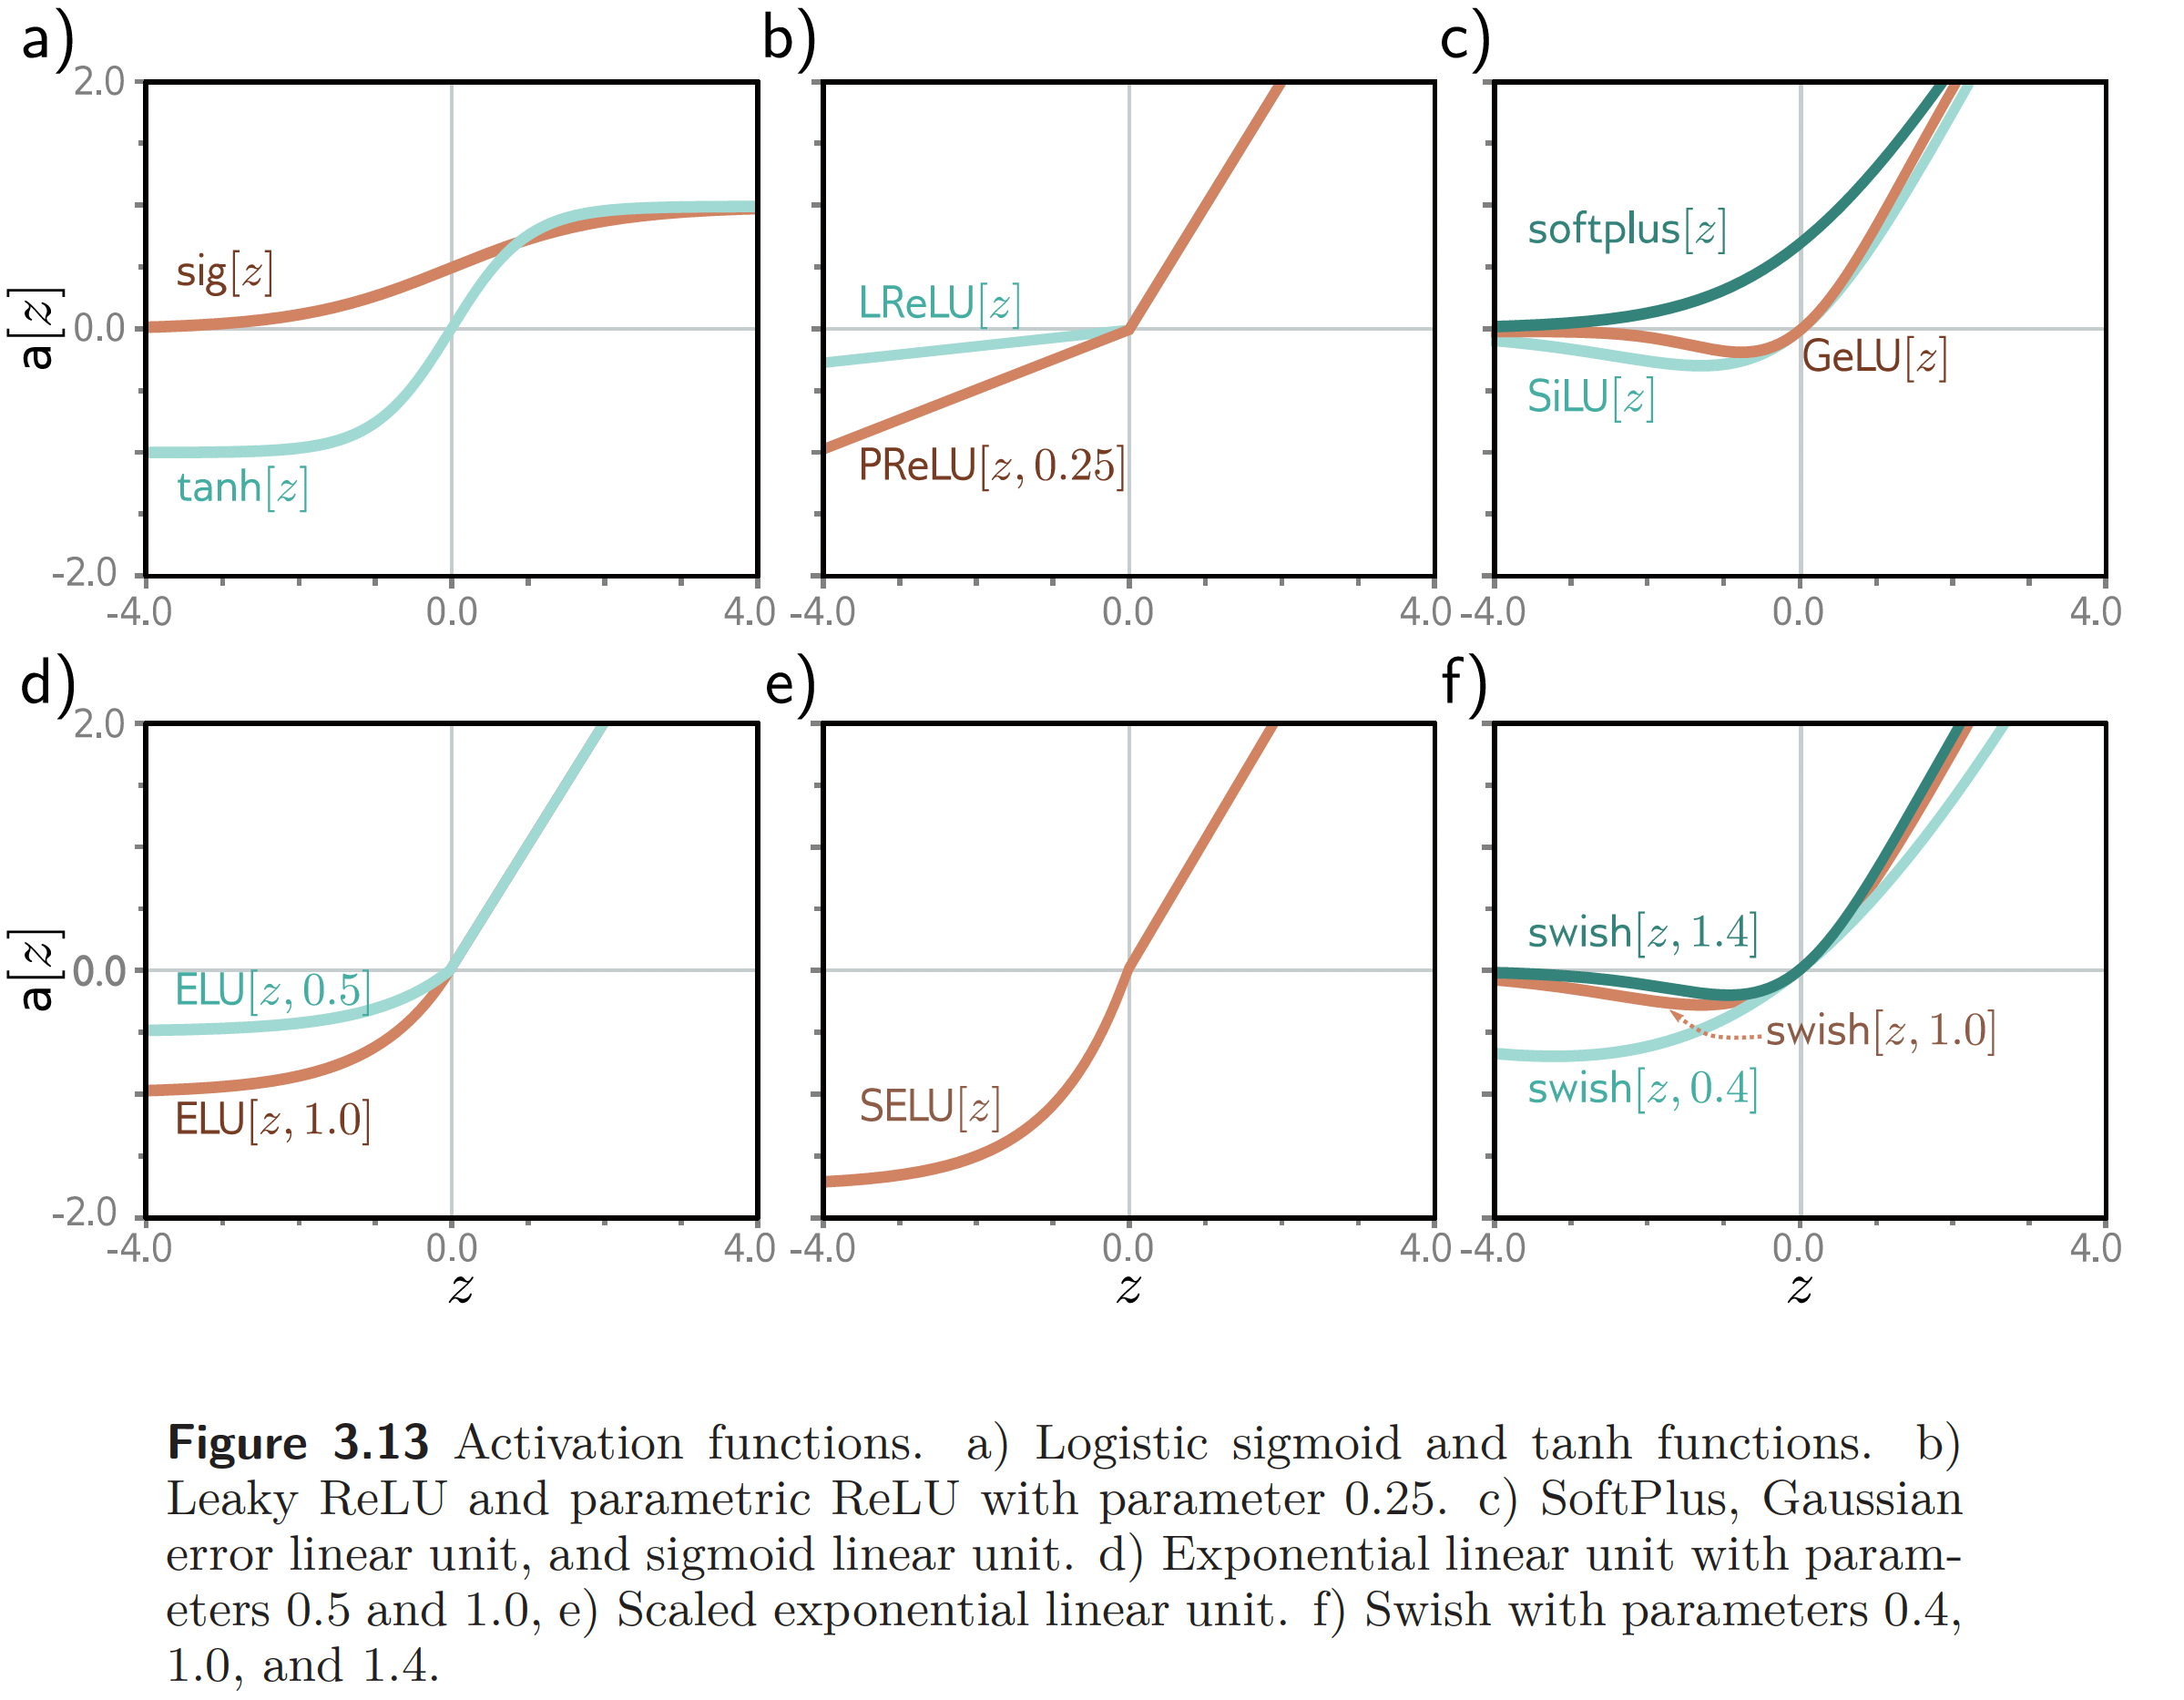
Activation functions
Source: Understanding Deep Learning, S. Prince, 2023
This work is subject to a Creative Commons CC-BY-NC-ND license. (C) MIT Press.

Slide 5
Activation functions
Sigmoid: not blowing up activation
ReLU : not vanishing gradient
ReLU : More computationally efficient to compute than Sigmoid like functions since ReLU just needs to pick max(0,𝑥) and not perform expensive exponential operations as in sigmoids
ReLU : In practice, networks with ReLU tend to show better convergence performance than sigmoid. (Krizhevsky et al.)
By default, use ReLU
ImageNet Classification with Deep Convolutional
Neural Networks, Krizhevsky, Sutskever and Hinton, NIPS 2012

Slide 6
Let’s venture into the variations of a deep networks
Network architecture and inductive bias
Loss function
Activation function
Regularization
Initialization
Residual networks
Batch norm, layer norm

Slide 7
Regularization
Regularization is about reducing the generalization gap between training and testing performance.
Implicit regularization is baked into SGD.
Explicit regularization is added through various methods (penalty term, data augmentation, dropout, etc.)

Slide 8
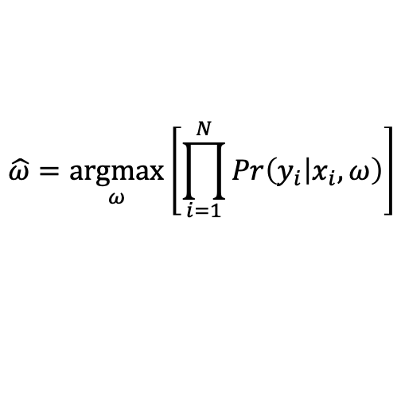
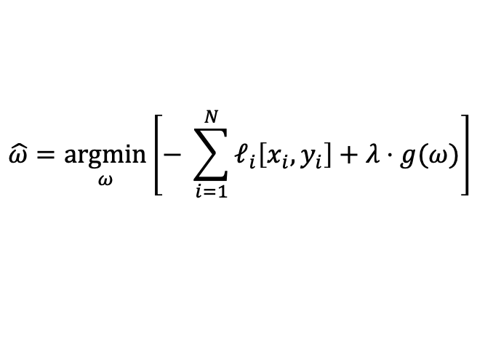
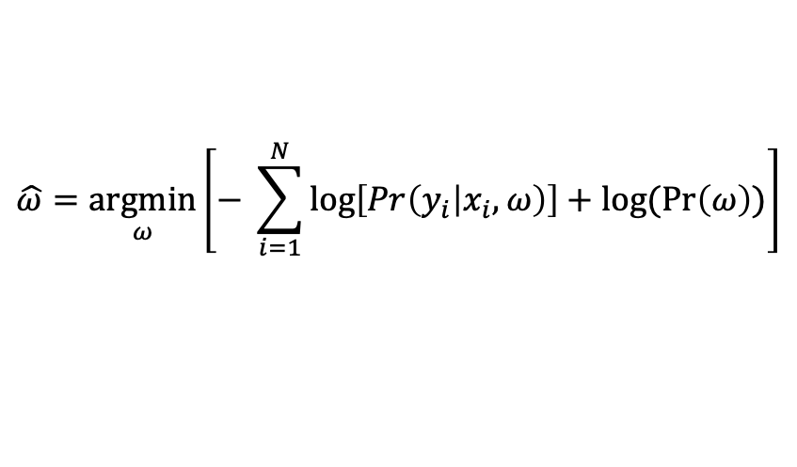
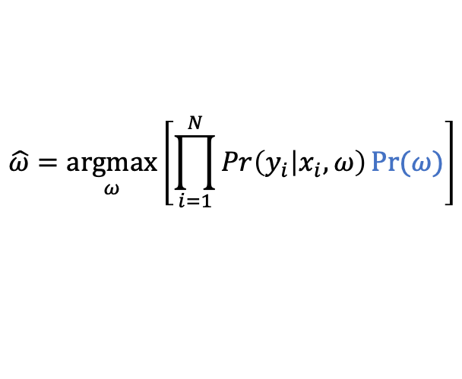
Regularization
Explicit regularization: adding a penalty term to the loss function
$$\hat{ω}=\underset{ω}{argmax}\left[\prod_{i=1}^{N}{Pr\left(y_{i} | x_{i},ω\right)}\right]$$
$$\hat{ω}=\underset{ω}{argmax}\left[\prod_{i=1}^{N}{Pr\left(y_{i} | x_{i},ω\right)}Pr⁡(ω)\right]$$
$$\hat{ω}=\underset{ω}{argmin}\left[− \sum_{i=1}^{N}{\log\left[Pr\left(y_{i} | x_{i},ω\right)\right]+log⁡(\operatorname{Pr}\left(ω\right))}\right]$$
$$\hat{ω}=\underset{ω}{argmin}\left[− \sum_{i=1}^{N}{ℓ_{i}\left[x_{i},y_{i}\right]+λ⋅g(ω)}\right]$$
penalty term

Slide 9
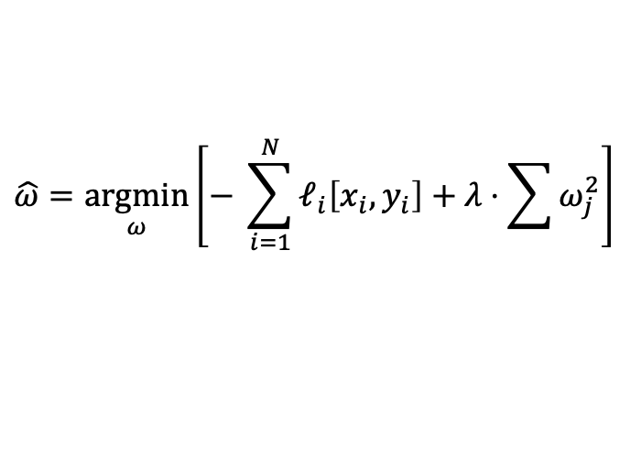
Regularization
Explicit regularization: adding a penalty term to the loss function
$$\hat{ω}=\underset{ω}{argmin}\left[− \sum_{i=1}^{N}{ℓ_{i}\left[x_{i},y_{i}\right]+λ⋅\sum{ω_{j}^{2}}}\right]$$
L2 loss

Slide 10
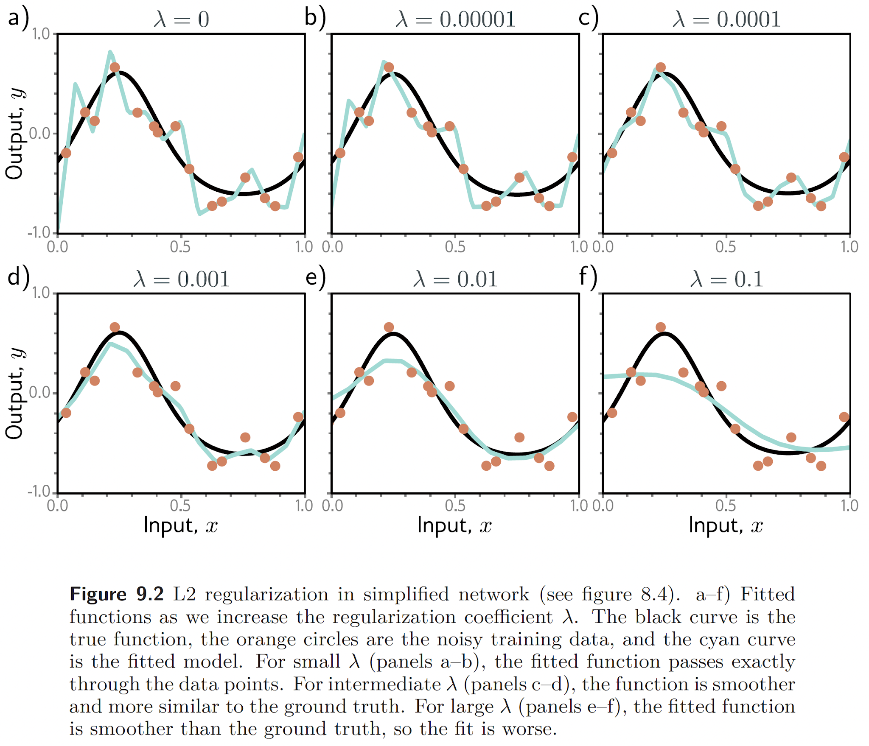
Regularization
Source: Understanding Deep Learning, S. Prince, 2023

Slide 11
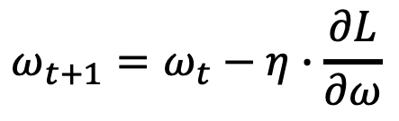
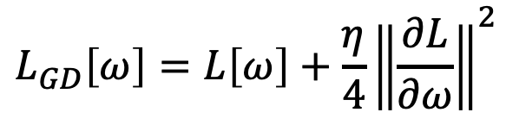
Regularization
Implicit regularization due to gradient descent
$$ω_{t+1}=ω_{t}−η∙\frac{∂L}{∂ω}$$
$$L_{GD}\left[ω\right]=L\left[ω\right]+\frac{η}{4}{\left\|\frac{∂L}{∂ω}\right\|}^{2}$$
implicit penalty

Slide 12
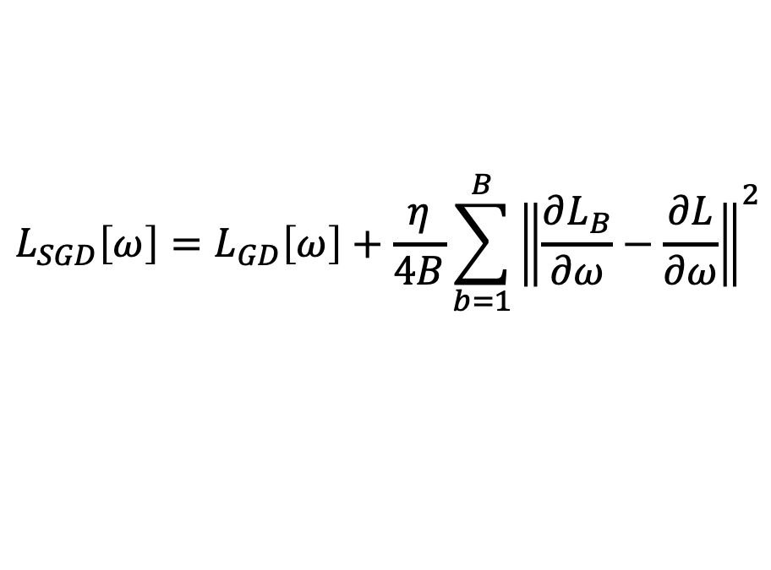
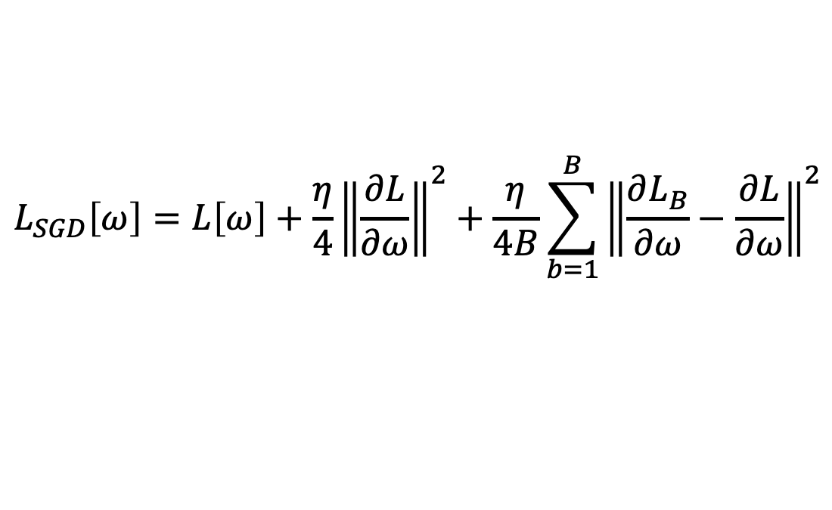
Regularization
Implicit regularization due to stochastic gradient descent
If we denote $L$ the average loss overall all samples and $L_{B}$ the average loss over all batches:
$$L_{SGD}\left[ω\right]=L_{GD}\left[ω\right]+\frac{η}{4B}\sum_{b=1}^{B}{{\left\|\frac{∂L_{B}}{∂ω}−\frac{∂L}{∂ω}\right\|}^{2}}$$
$$L_{SGD}\left[ω\right]=L\left[ω\right]+\frac{η}{4}{\left\|\frac{∂L}{∂ω}\right\|}^{2}+\frac{η}{4B}\sum_{b=1}^{B}{{\left\|\frac{∂L_{B}}{∂ω}−\frac{∂L}{∂ω}\right\|}^{2}}$$
Larger steps regularize more
Smaller batches regularize more

Slide 13
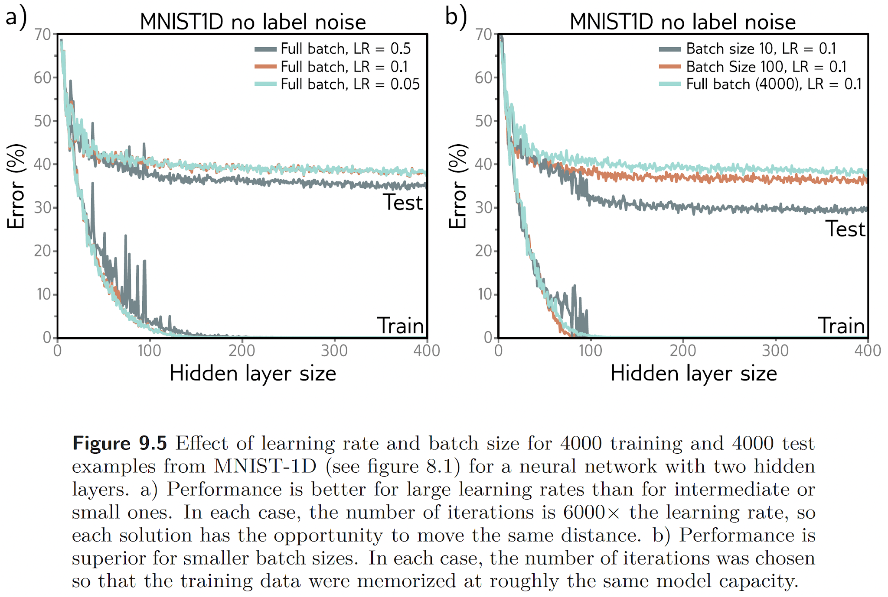
Larger learning rate regularize more
Smaller batches regularize more
Source: Understanding Deep Learning, S. Prince, 2023

Slide 14
Regularization
Heuristics to add regularization:
Early stopping
Ensembling
Dropout
Data augmentation

Slide 15
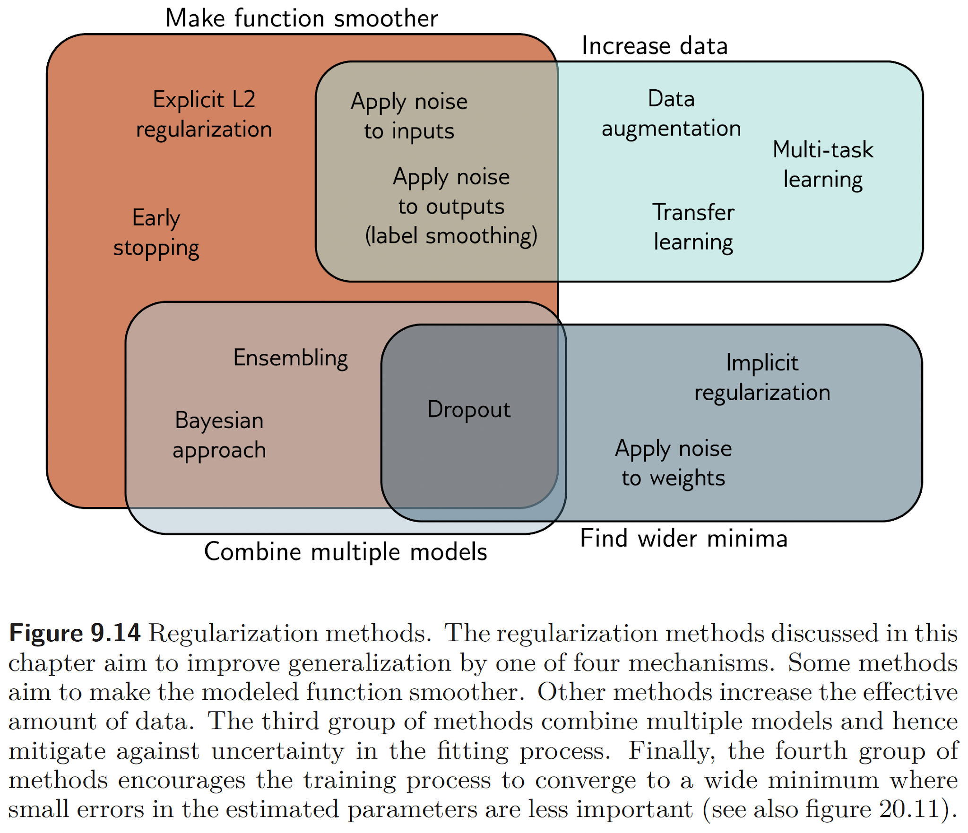
Regularization: summary
Source: Understanding Deep Learning, S. Prince, 2023

Slide 16
Let’s venture into the variations of a deep networks
Network architecture and inductive bias
Loss function
Activation function
Regularization
Initialization
Residual networks
Batch norm, layer norm

Slide 17
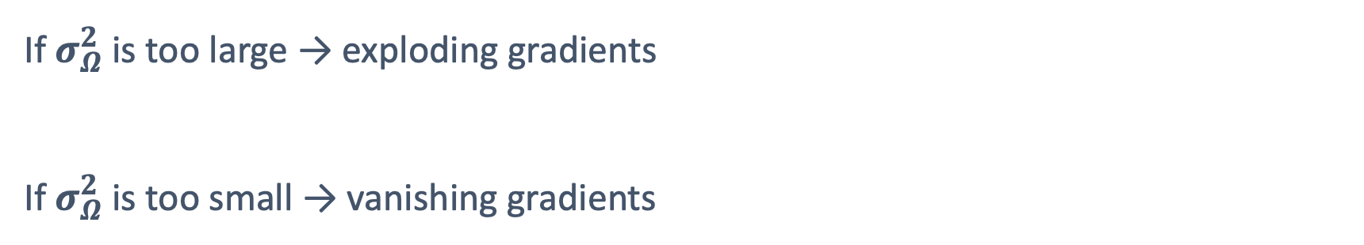
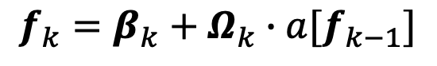
Initialization: forward pass
At each layer $k$, given weights $Ω$ with variance $σ_{Ω}^{2}$ and pre-activations $f_{k}:$
$$f_{k}=β_{k}+Ω_{k}∙a[f_{k−1}]$$
If $σ_{Ω}^{2}$ is too large → exploding gradients
If $σ_{Ω}^{2}$ is too small → vanishing gradients

Slide 18
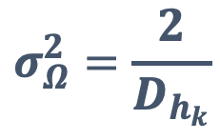
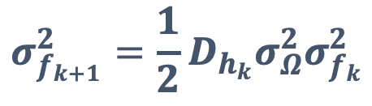
Initialization: forward pass
At each layer $k$, given weights $Ω$ with variance $σ_{Ω}^{2}$ and pre-activations $f_{k}:$
$$σ_{f_{k+1}}^{2}=\frac{1}{2}D_{h_{k}}σ_{Ω}^{2}σ_{f_{k}}^{2}$$
where $D_{h_{k}}$ is the dimensionality of the input layer $k$.
Hence the optimal variance of the weights is:
$$σ_{Ω}^{2}=\frac{2}{D_{h_{k}}}$$
He initialization

Slide 19
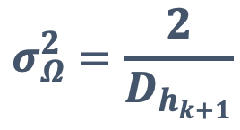
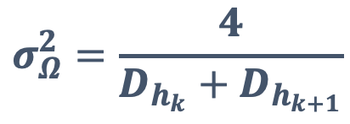
Initialization: backward pass
Similarly, the optimal variance of the weights for the backward pass is:
$$σ_{Ω}^{2}=\frac{2}{D_{h_{k+1}}}$$
Overall, the optimal variance of the weights is:
$$σ_{Ω}^{2}=\frac{4}{{D_{h_{k}}+D}_{h_{k+1}}}$$
Delving Deep into Rectifiers: Surpassing Human-Level Performance on ImageNet Classification, He et al., ICCV 2015

Slide 20
Let’s venture into the variations of a deep networks
Network architecture and inductive bias
Loss function
Activation function
Regularization
Initialization
Residual networks
Batch norm, layer norm

Slide 21
Residual networks
Gradient descent assumes that the function is smooth.
Unfortunately, the loss becomes less and less smooth with more depth
(shattered gradients).

Slide 22
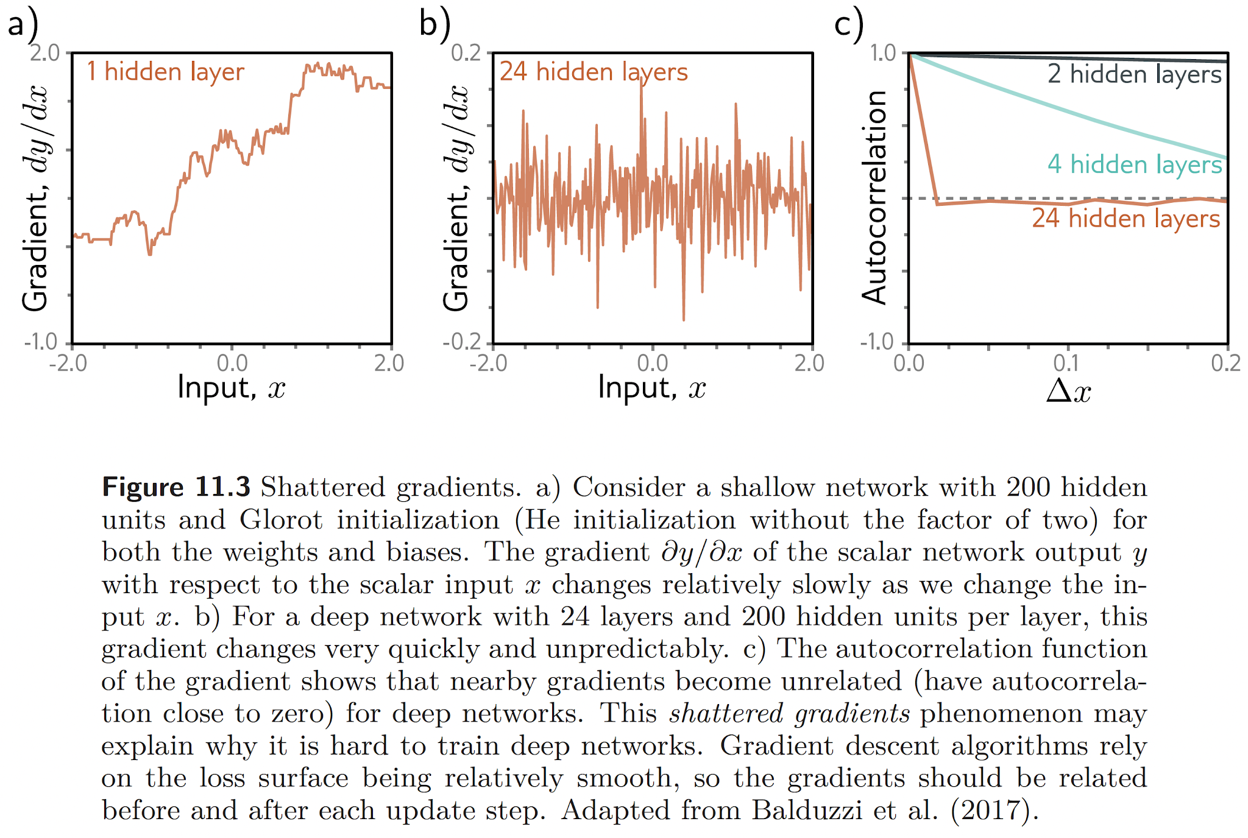
Residual networks
Source: Understanding Deep Learning, S. Prince, 2023

Slide 23
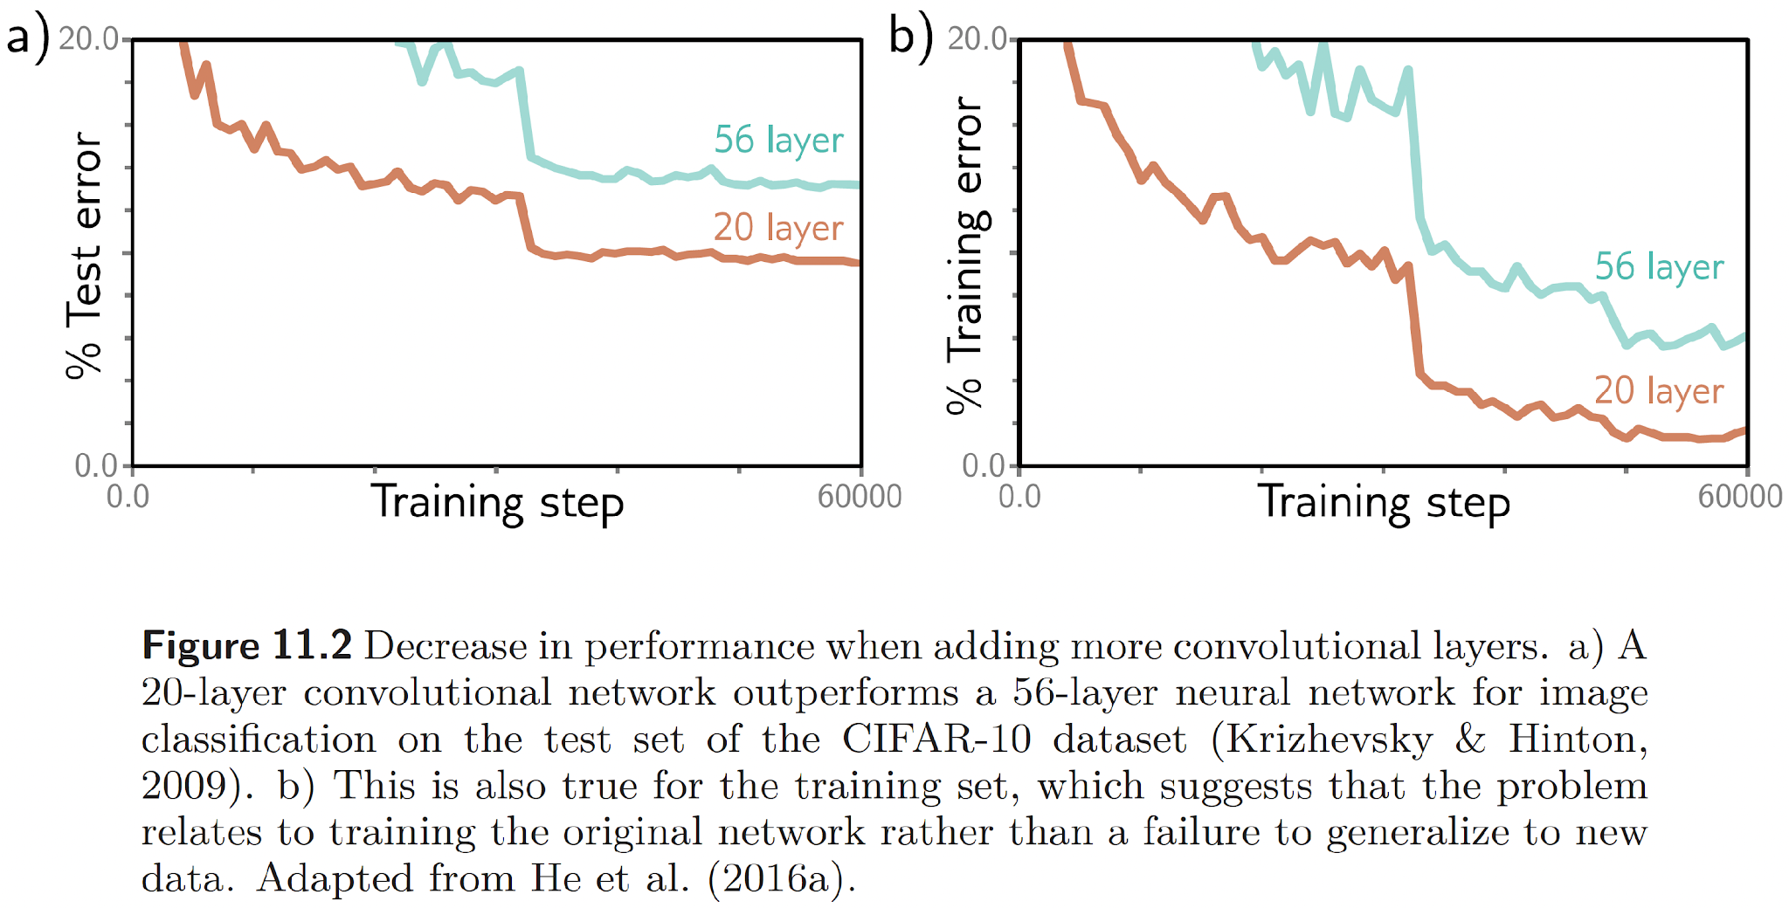
Residual networks
More depth is not always better!
Source: Understanding Deep Learning, S. Prince, 2023

Slide 24
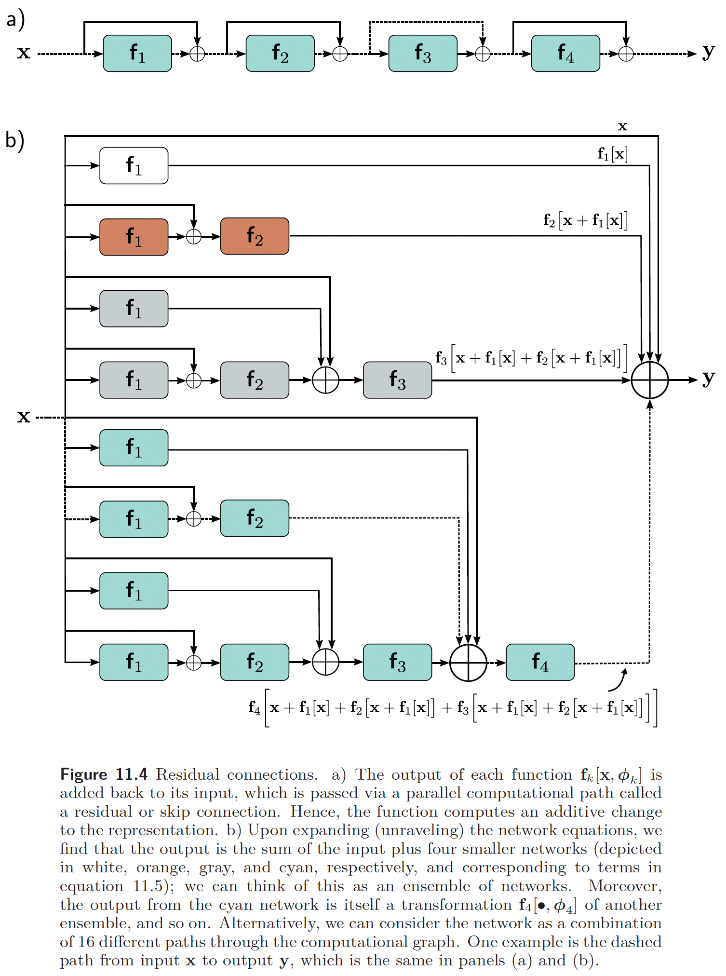
Residual networks
This can be addressed with skip connections.
Source: Understanding Deep Learning, S. Prince, 2023

Slide 25
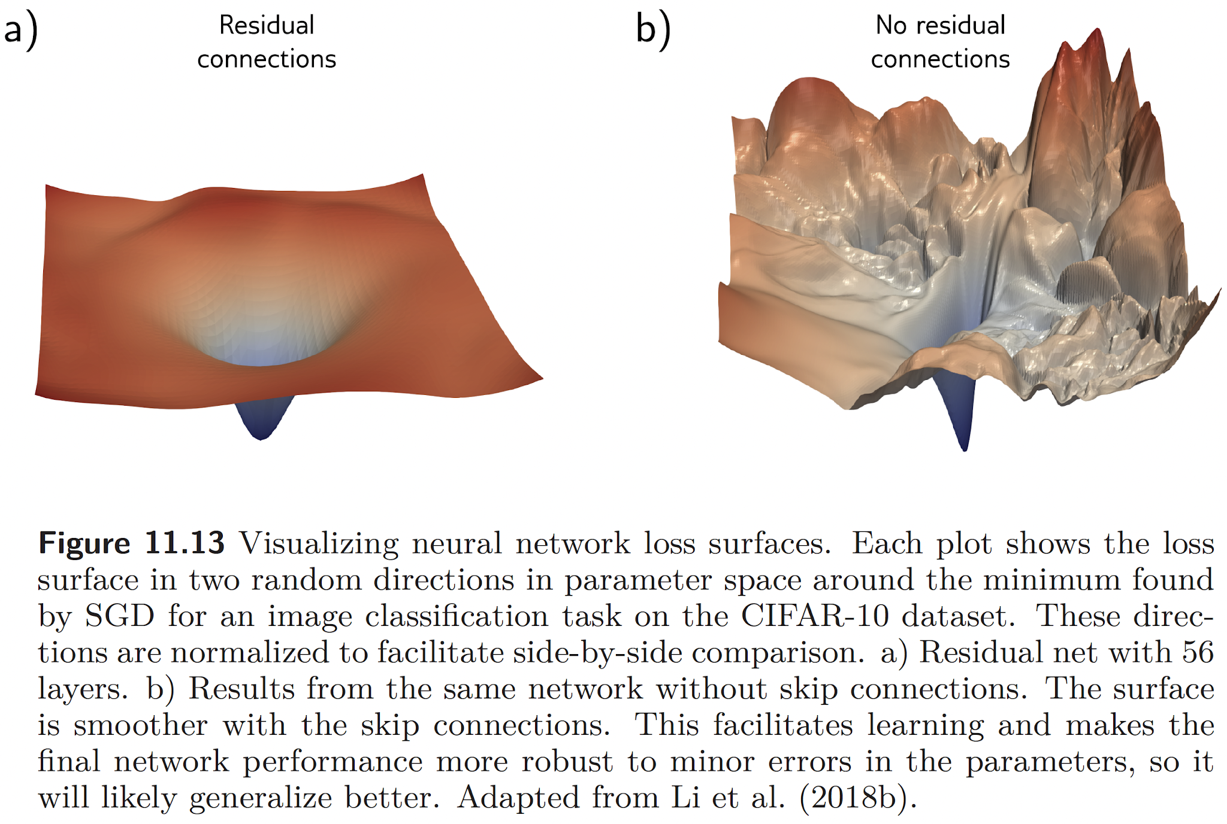
Residual networks
This can be addressed with skip connections.
Source: Understanding Deep Learning, S. Prince, 2023

Slide 26
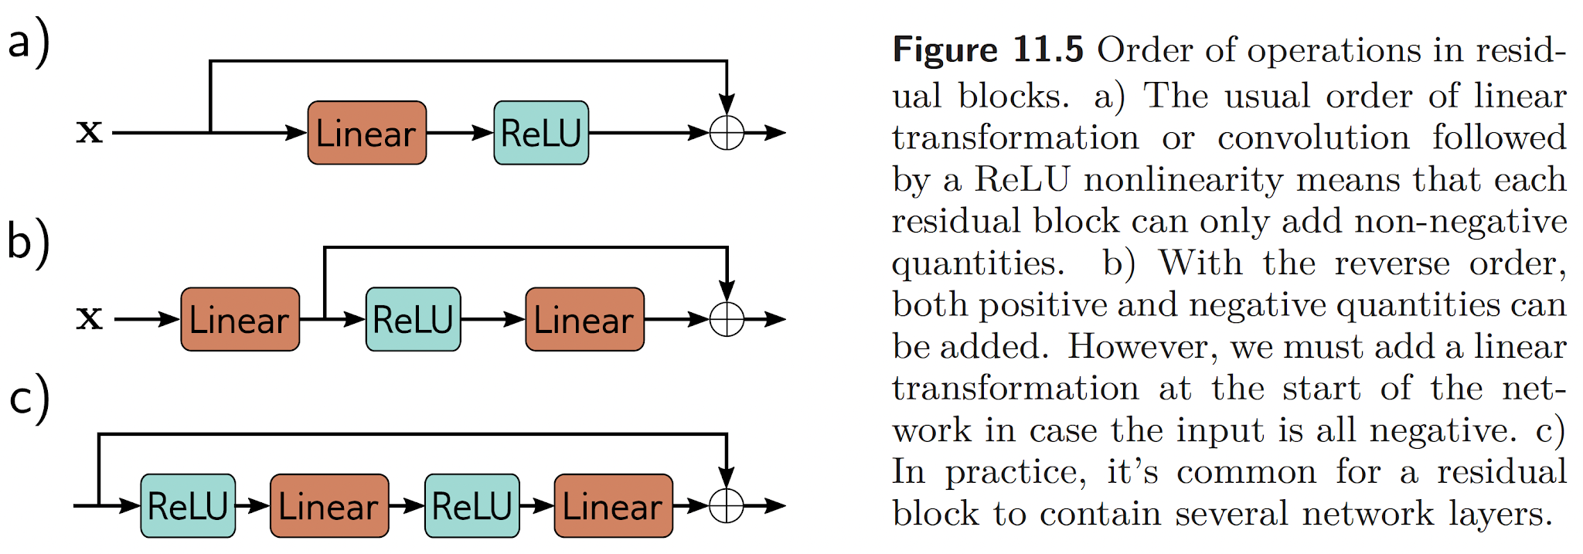
Residual networks
But then we need to update the order of operations.
Source: Understanding Deep Learning, S. Prince, 2023

Slide 27
Residual networks
But then the variance doubles at every layer! -> Batch norm
Source: Understanding Deep Learning, S. Prince, 2023

Slide 28
Let’s venture into the variations of a deep networks
Network architecture and inductive bias
Loss function
Activation function
Regularization
Initialization
Residual networks
Batch norm, layer norm

Slide 29
Batch norm
Batch Norm addresses the exploding gradient problem.
Alternative intuition:
We initialize the weights so that they have a nice distribution.
Why don’t we do this at each pass then? ☺
That’s Batch Norm!
Introduced by Ioff & Szegedy (2015)

Slide 30
Batch norm
Shift and scale each activation so that their mean and variance across the batch become values that are learned during training.
Not constant values!

Slide 31
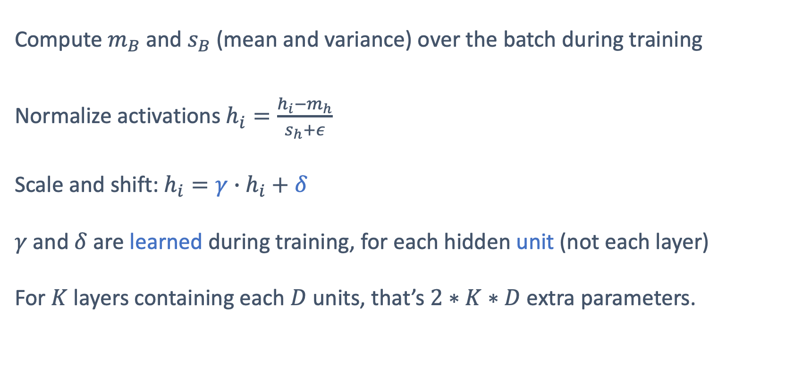
Batch norm
Compute $m_{B}$ and $s_{B}$ (mean and variance) over the batch during training
Normalize activations $h_{i}=\frac{h_{i}−m_{h}}{s_{h}+ε}$
Scale and shift: $h_{i}=γ∙h_{i}+δ$
$γ$ and $δ$ are learned during training, for each hidden unit (not each layer)
For $K$ layers containing each $D$ units, that’s $2∗K∗D$ extra parameters.

Slide 32
Batch norm
Downsides of Batch Norm
Prone to bugs (need to freeze during inference)
More parameters to learn
Introduces dependencies between the training samples
Needs to recompute the statistics on the whole dataset at testing time

Slide 33
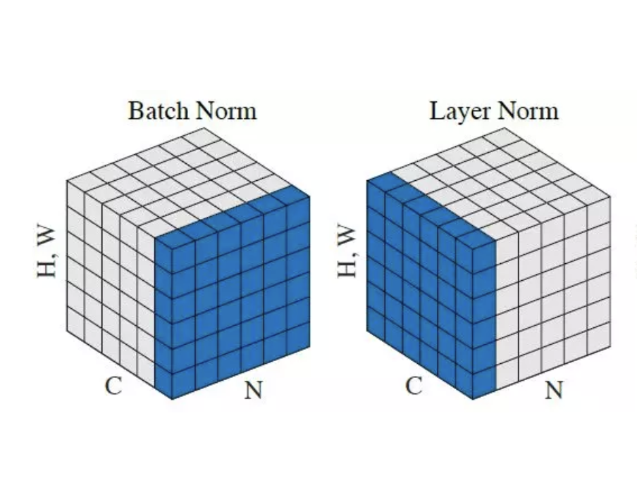
Layer norm
Compute the layer normalization statistics over all the hidden units in the same layer.
All the hidden units in a layer share the same normalization terms
μ and σ, but different training cases have different normalization terms.
Introduced by Ba et al. in Layer Normalization

Slide 34
Conclusion
The choice of the loss function is critical.
Deep learning adds inductive bias.
Deep learning is not supposed to work (in theory).
Yet, it works thanks to:
Activation function
Regularization
Initialization
Residual networks
Normalization

Slide 35
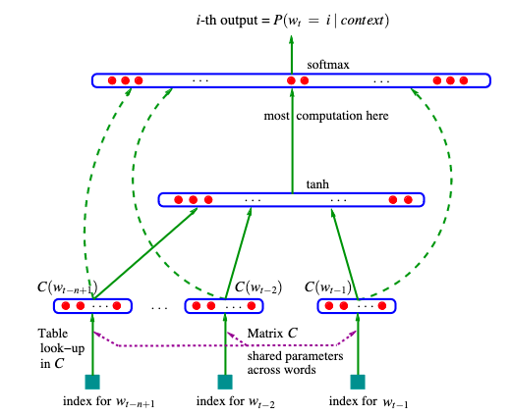
Going beyond N-gram with Recurrent Neural Networks (RNNs)
Neural Probabilistic Language Model
A Neural Probabilistic Language Model, Bengio et al, 2003

Slide 36
Going beyond N-gram with Recurrent Neural Networks (RNNs)
Neural Probabilistic Language Model
Main limitation: fixed length context
A Neural Probabilistic Language Model, Bengio et al, 2003

Slide 37
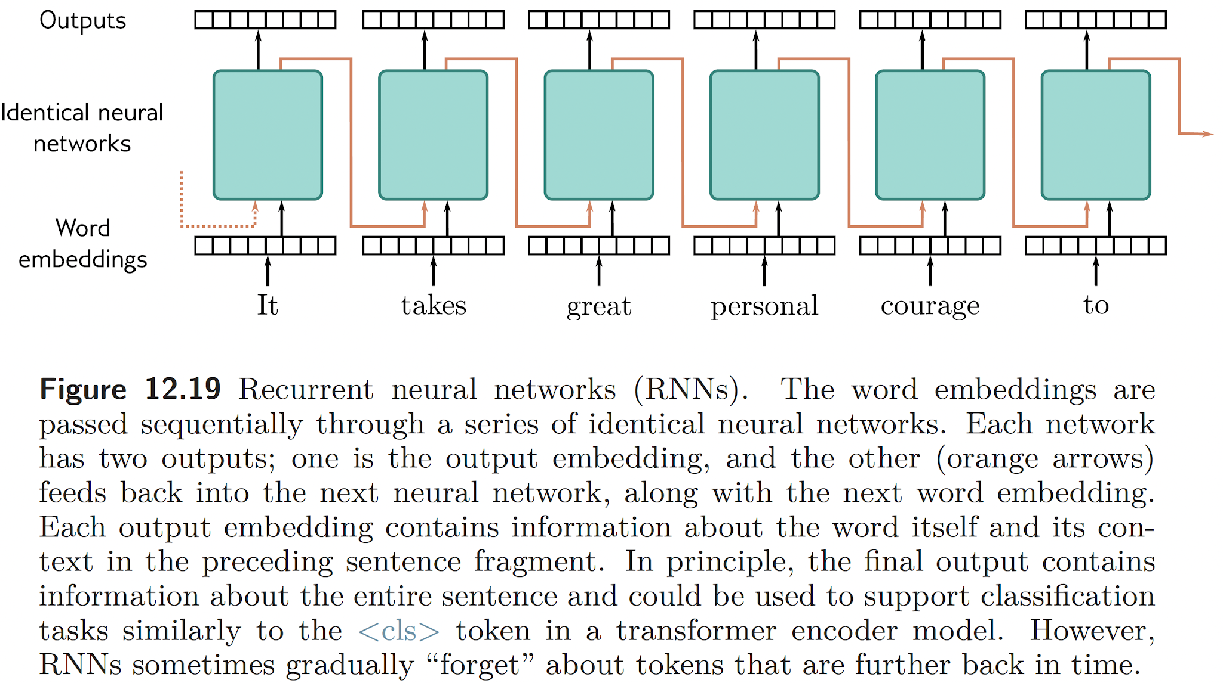
Going beyond N-gram with Recurrent Neural Networks (RNNs)
Source: Understanding Deep Learning, S. Prince, 2023

Slide 38
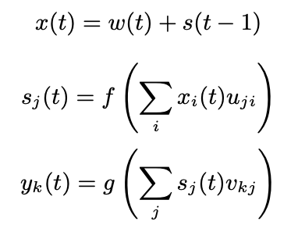
Going beyond N-gram with Recurrent Neural Networks (RNNs)
RNNs
Input layer
Context /
hidden state
Output layer
Recurrent neural network based language model, Mikolov et al, InterSpeech, 2010

Slide 39
Going beyond N-gram with Recurrent Neural Networks (RNNs)
Standard RNNs are unable to store information about past inputs for very long.
Learning Long-Term Dependencies with Gradient Descent is Difficult, Bengio et al, 1994.

Slide 40
Going beyond N-gram with Recurrent Neural Networks (RNNs)
LSTM
Long Short-term Memory is an RNN architecture designed to
be better at storing and accessing information than standard RNNs.
Generating Sequences With Recurrent Neural Networks, A. Graves, 2014

Slide 41
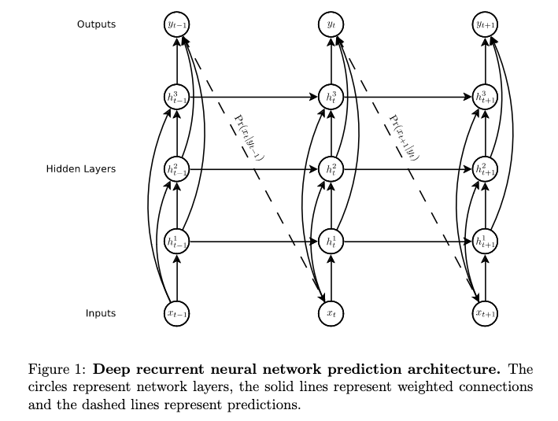
Going beyond N-gram with Recurrent Neural Networks (RNNs)
Generating Sequences With Recurrent Neural Networks, A. Graves, 2014

Slide 42
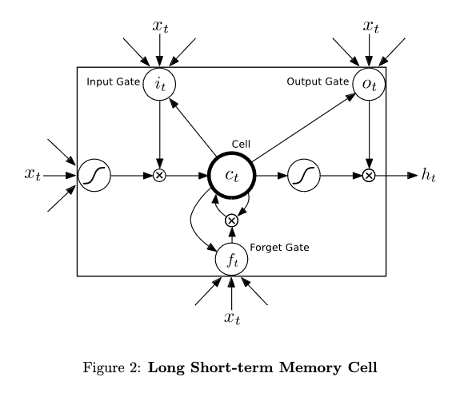
Going beyond N-gram with Recurrent Neural Networks (RNNs)
Generating Sequences With Recurrent Neural Networks, A. Graves, 2014

Slide 43
Going beyond N-gram with Recurrent Neural Networks (RNNs)
Better LSTMs
Sequence to sequence learning with neural networks, Sutskever, I., Vinyals, O., and Le, Q. , NIPS 2014.
Neural Machine Translation by Jointly Learning to Align and Translate, D. Bahdanau, K. Cho, Y. Bengio, 2015
GRUs (Gated Recurrent Units)
On the Properties of Neural Machine Translation: Encoder-Decoder Approaches, K. Cho et al, 2014

Slide 44
Going beyond N-gram with Recurrent Neural Networks (RNNs)
GRU and LSTM seem comparable in performance.
They suffer from the same limitations:
Compressing the input sequence into a single vector.
Empirical Evaluation of Gated Recurrent Neural Networks on Sequence Modeling, J. Chung, C. Gulcehre, K. Cho, Y. Bengio, 2014.

Slide 45
Attention and Transformers
The restaurant refused to serve me a ham sandwich because it only cooks vegetarian food. In the end, they just gave me two slices of bread. Their ambiance was just as good as the food and the service.

Slide 46
Attention and Transformers
The restaurant refused to serve me a ham sandwich because it only cooks vegetarian food. In the end, they just gave me two slices of bread. Their ambiance was just as good as the food and the service.

Slide 47
Attention and Transformers
Main constraints of NLP
1. NLP tasks often induce variable-length inputs.
2. Language is ambiguous: we need words/tokens to pay attention to each other.
3. Brute-force encoding the input generates large vectors: 37 words represented by 1024 embeddings -> 37,888 dimensions.
We need an efficient communication mechanism between words/tokens.

